Slide 1
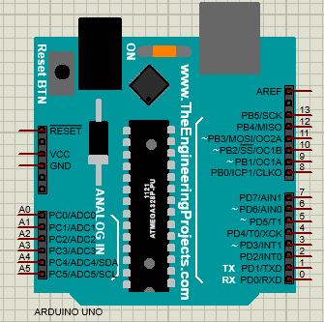
ARDUINO

Slide 2
Introduction
Arduino is an open-source prototype platform consisting of hardware (microcontroller board) and software (Arduino IDE).
It allows users to write and upload code to control the hardware.
It is used for interactive projects involving sensors, actuators, and communication with computers .

Slide 3
Cont..
Arduino is an open-source physical computing platform based on a simple i/o board and a development environment that implements the Processing / Wiring language.
Arduino can be used to develop stand-alone interactive objects or can be connected to software on your computer.
Arduino boards are able to read analog or digital input signals from different sensors and turn it into an output such as activating a motor, turning LED on/off, connect to the cloud and many other actions.

Slide 4
Cont…
In simple term microcontroller is a computer on a single chip (board). Additionally it is controlled by the program written by the user.
A microcontroller is a small computer on a single chip that includes a processor, memory, and input/output (I/O) interfaces.
It is an electronic device which contains the microprocessor with integrated peripherals like memory, serial ports, timer/counter, interrupt controller, data acquisition interfaces like ADC,DAC.

Slide 5
Cont..
There are a number of different microcontroller out there some of the popular microcontroller are:
8051 Microcontroller: is an 8 bit family of microcontroller is developed by the intel. It is the most popular families of microcontroller.
PIC Microcontroller: Peripheral interface controller (PIC) is microcontroller developed by a microchip. PIC microcontroller is fast and simple to implement program when we contrast with other microcontrollers like 8051.
AVR Microcontroller: It was developed in the year of 1996 by Atmel corporation. It is RISC (reduced instruction set computer) microcontroller so that it can operate at higher speed (perform more millions of instruction per second

Slide 6
Cont…
By incorporating microcontroller into device in the appropriate way we can build more than what we could imagine. Application area of microcontrollers are wide but the following are some of them.
Consumer Electronics: microcontroller are used in appliance like Toys, Cameras, Robots, washing machine, microwave oven, musical instrument and its used in almost any automatic home appliance.
Touch Screen: cell phone, media player and gaming device are examples of microcontroller based touch screens.
Office Equipment: most of office equipment like fax machine, printers and other incorporate microcontrollers.
Medical: Movable medical devices such as blood pressure and glucose monitors use of microcontroller will to show data thus provided that higher reliability in providing medical results microcontroller additionally they are also used in a device like ECG machine.

Slide 7
Cont…
why you need to learn Arduino ? Why it is this much crucial ?
Arduino is the best way to build interactive project.
Arduino is easy to program and interface with sensors/actuators.
It has a large online community and support system.
Useful for scientific experiments, prototyping, and automation projects
You don’t need to be an expert in electronics to use it.

Slide 8
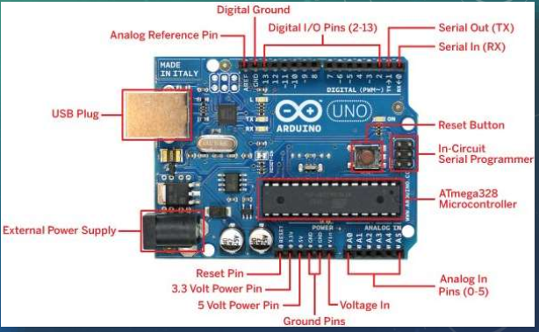
Board parts

Slide 9
Cont…
Arduino UNO board parts and their functions:
USB Plug – Used to connect the Arduino to a computer for programming and power.
External Power Supply – Allows external power (DC adapter or battery) to power the board (7V-12V recommended).
Reset Pin – Used to reset the Arduino program.
3.3V & 5V Power Pins – Provides regulated voltage for sensors and modules.
Ground (GND) Pins – Used for circuit grounding.
Voltage In (Vin) – Provides input power if using an external power source.
Analog Reference Pin (AREF) – Provides a reference voltage for analog inputs.
.

Slide 10
Cont…
Arduino UNO board parts and their functions:
Input Pins (A0-A5) – Reads analog sensor values (e.g., temperature, light).
Digital I/O Pins (2-13) – Can be used as input/output for components like LEDs, buttons, and sensors.
Serial Out (TX) & Serial In (RX) – Used for serial communication (sending and receiving data).
Digital Ground – Ground connection for digital circuits.
Reset Button – Restarts the code running on the board.
In-Circuit Serial Programmer (ICSP) – Used for direct programming of the microcontroller.
ATmega328 Microcontroller – The main processing unit of the Arduino, responsible for running the program.

Slide 11
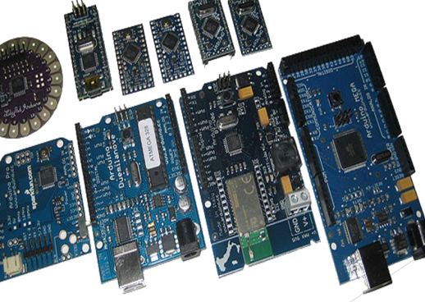
Type of Arduino interface board
There are many type of Arduino board based on there
clock speed
Number of input output pin and
physical size
Some of this are:
Arduino Uno
Arduino Due
Arduino Mega
Arduino Leonardo

Slide 12
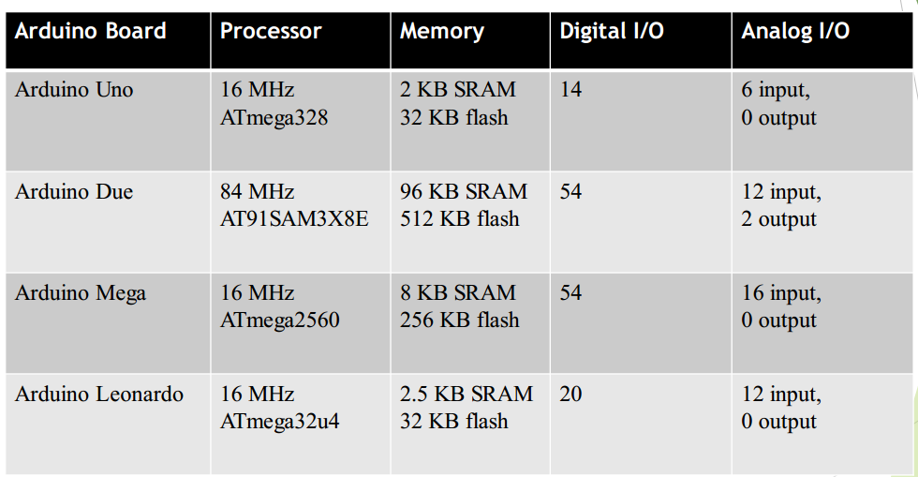
Cont..

Slide 13
Cont…
Eight bit microcontroller – brain of the board
USB Port – to communicate with the desktop/laptop
USB controller chip – manages USB transferred data
IO pins – board’s connection to the outside world
Quartz oscillator – board’s time keeper
Reset button – taking the board back to its initial state
External power jack – power from dedicated source Co-axial jack, but USB can also be used

Slide 14
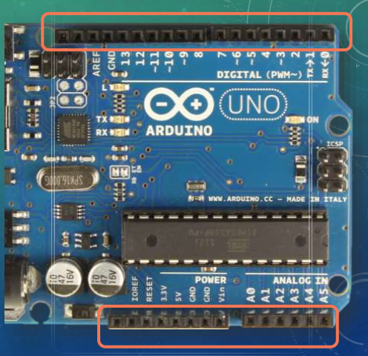
Cont….
Top and bottom rows of the board
Holes in the board which we can stick wires in
Holes are connected to the chips through traces on-board
14 Digital I/O pins on top [0-13]
Highs – 5 volts Lows – 0 volts Max Current - 40 mA
6 Analog input pins on the bottom [A0 – A5]
Power output pins on the bottom [ 5v , 3.3 v ]
Reset pin to reset the board to initial state

Slide 15
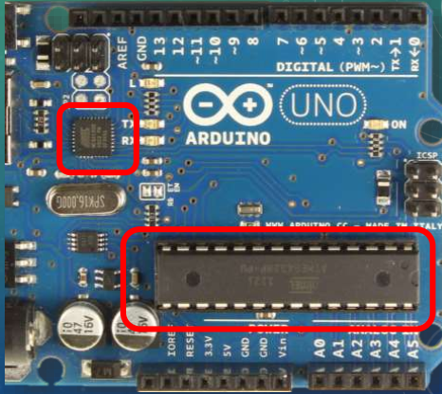
cont…
MICROCONTROLLERS
Two microcontrollers on the board
Main ATmega328 – 8 bit microcontroller User programmable, runs user-written application code Carries firmware, like bootloader
ATmega16U2: Handles the communication with the USB interface, not directly accessible
STORAGE & MEMORY
Non-volatile flash memory for storage
32 kilobytes in size
Static Random Access Memory (SRAM) for
memory (volatile)
3 kilobytes in size

Slide 16
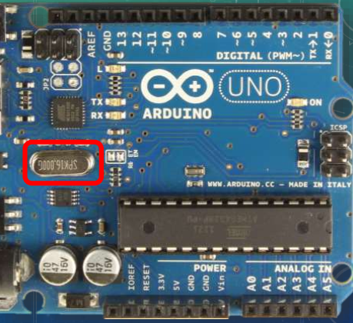
Cont…
CLOCK
16 MHz clock speed ~ 16 million operations per second
Helps synchronize all components together
Keeping track of occurrence of events

Slide 17
Arduino IDE
Arduino Integrated Development Environment (IDE) is a piece of software you run on your computer.
You use the IDE to create a sketch (a little computer program) that you upload to the Arduino board through serial port.
Arduino sketch is a computer program (code) written to tell Arduino what to do.
Arduino programs can be divided in three main parts:
Structure,
Values (variables and constants),
and Functions.

Slide 18
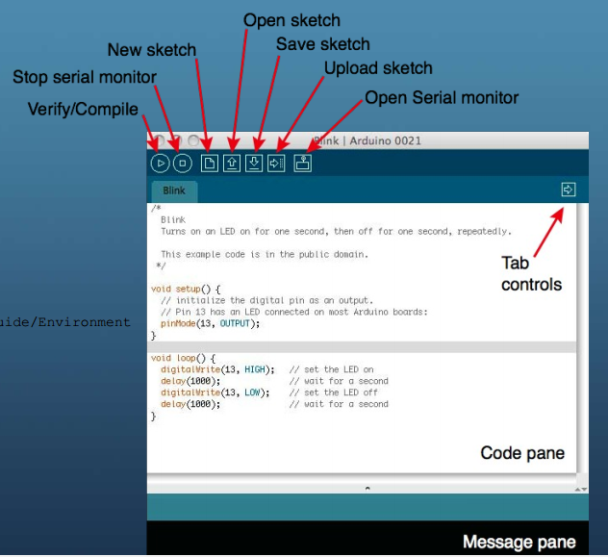
Cont…

Slide 19
Cont…
The setup() function is called when a sketch starts.
Use it to initialize the variables, pin modes, start using libraries, etc.
The setup function will only run once, after each power up or reset of the Arduino board.
Initialize the mode of the pin.
Initialize Serial communication
Other thing we want to execute ones this written in this function.

Slide 20
Cont…
After creating a setup() function, which initializes and sets the initial values, the loop() function does precisely what its name suggests, and loops consecutively, allowing your program to change and respond.
Use it to actively control the Arduino board.
Execute the main logic program.
Hold the code that we need to execute repeatedly.

Slide 21
Arduino I/O function
One of the main jobs of Arduino is to input information from sensors and output values to actuators.
This is achieved using Arduino I/O function. These function are:
pinMode(pin, mode):- Is used to configures the specified pin to behave either as an INPUT pin or an OUTPUT pin. As the parameter of this function pin is the pin number on board.
digitalWrite(pin, value):- Write a HIGH or a LOW value to a digital pin.
digitalRead(pin):- Reads the value from a specified digital pin. The result will be either HIGH or LOW.

Slide 22
Cont…
analogRead(pin):- Reads the value from the specified analog pin (A0 – A5). The reading returns a 10-bit value with a range of integers from 0 to1023 corresponding to the input voltage on the pin.
analogWrite(pin, duty cycle):- The function analogWrite() will allow us to access the pulse width modulation hardware on the Arduino microcontroller.
Serial.begin(baud_Rate):- This sets up our serial communication to occur at the specified baud rate.
Note that the sending and receiving end need to use the same massage protocol.

Slide 23
cont
Serial.available():- This function has no parameters but will instead return the number of available bytes waiting in the serial buffer. If no data is waiting for us, it will return 0.
Serial.read():-This function simply returns the first byte of information available in the serial buffer
Serial.print(data):- This function is used for printing ASCII characters to the connected serial device. It simply returns the first byte of information available in the serial buffer.

Slide 24
Cont…
Serial.println(data):-function is short for print line. After printing the specified data, it will return to the next line and start again.
map(X,a,b,y,z):- It is used to map the value of variable ‘X’ with the range of value from a-b to the range value between y-z.
tone(pin,frequency,duration):- using this function we can make the specified Arduino pin which is connected to the speaker to generate sound at the specified frequency for specified length of time (duration).

Slide 25
Cont….
delay( time in ms):- Is used to delay the execution of program for the amount of specified milliseconds.
delayMicroseconds( time in µs):- Is used to create a short delay in microsecond. since the microcontroller performs thing in fraction of seconds we may need to create a short pause in the middle of a program.
Write(angle) used to write the amount of angle for servo motor

Slide 26
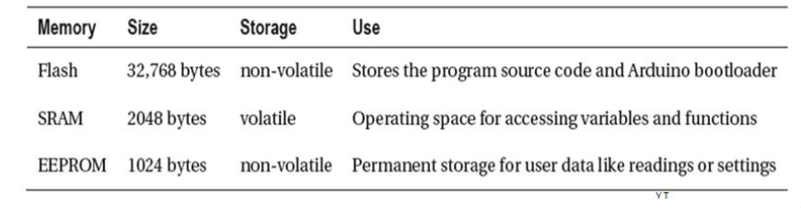
Arduino memory
There are three separate types of memory found inside the Atmel ATmega328 microcontroller used on the Arduino Uno interface board
Flash
RAM (SRAM)
EEPROM

Slide 27
Arduino bootloader
The Arduino bootloader is a small program stored in the microcontroller’s flash memory. It enables the Arduino to receive and execute code without needing an external programmer.
When we are dealing with the complex Arduino program we face one problem memory space problem because Arduino have only about 32kbyte space to store program instruction.
To make sure efficient use of memory we have to take measure this are:
Avoid using unnecessary Arduino library.
Try to use a data type with less memory space.
Avoid multiple declaration variable which can be declared using a single variable.

Slide 28
Serial communication
A meaningful serial communication, or any kind of machine to machine communications can only be achieved if the sending and receiving sides fully agree how information is organized in the message and at what speed they are being transmitted.
This organization of information in message and the speed at which it is transmitted is called a communication protocol.
A type of communication Arduino used to communicate with computer and other peripheral devices is called serial communication.

Slide 29
Cont…
Serial communication is a process of sending and receiving bytes of data in a sequential manner.
Two of the microcontroller’s pins are needed for this communication: pin 0 is the receive pin marked RX and pin 1 is the transmit pin marked TX.
The serial communications protocol sends data in 8-bit chunks, or 1-byte at a time. In the hardware implementation, the serial bus has an available buffer of 128 bytes

Slide 30
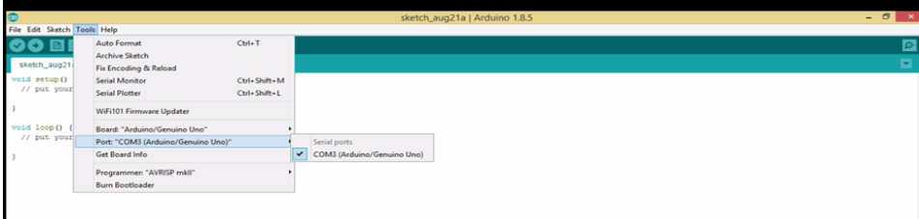
Cont…
To use Arduino serial communication we have to specify the serial port on the Arduino IDE.

Slide 31
Sensors and Actuators
Sensors and actuators are electronic components that allow a piece of electronics to interact with the world.
An actuator is the opposite of a sensor: a sensor senses something in the physical world and converts it to a signal a computer can understand, while an actuator converts a signal from a computer into an act in the physical world.
Sensors and actuators controlled by a behavior implemented as software running inside a microcontroller.

Slide 32
sensor
Sensors could be either analog or digital sensor;
digital sensors are a sensors which tells the weather something is happen or not like pushbutton or tilt switches while
analog sensors are that have more information than just on or off, like a potentiometer that can tell where it’s been turned to, or a light sensor that can tell how much light is on it
There are a lot of more sensor we could mention here today but for this tutorial class lets see some of them.

Slide 33
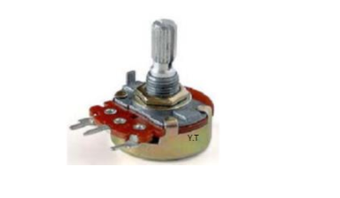
Potentiometer
A force sensitive resistor will respond to the amount of force applied to it.
A potentiometer (or "pot") is a variable resistor that allows you to manually adjust resistance and control voltage levels.
This special kind of resistor called a potentiometer will change resistance based on the position of a knob or slider or wiper.
The outer two terminals should be connected to GND and +5v respectively (polarities does not matter), whereas the center terminal should connect to an analog Input pin on the Arduino.

Slide 34
Cont…
Potentiometer is connected with Arduino and other electronic device but in general we can say that it is used to control different parameters of sensors and actuators.
This includes :-
To control speed of motor
To control the intensity of light
To control direction of servo motor and
To adjust input to different sensors

Slide 35
ULTRASONIC SENSOR
Ultrasonic sensor is non-contact distance measurement module.
It is perfect for measuring distance between two moving or non-moving bodies.
Ultrasonic sensors generate high frequency sound waves (40kHz) and evaluate the echo which is received back by the sensor.
Sensors calculate the time interval between sending the signal and receiving the echo to determine the distance to an object

Slide 36
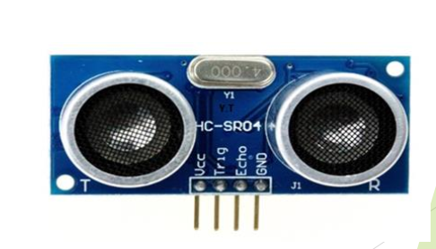
Cont…
This sensor has 4 pins: Vcc (Voltage in), Trig (Trigger), Echo, and GND (Ground).
If a 10μs width trigger pulse is sent to the signal pin, the Ultrasonic module will output eight 40kHz ultrasonic signal and detect the echo back.
The features of this sensor is:
Detecting range: 3cm-4m
Best in 30 degree angle
5VDC power supply
Breadboard friendly

Slide 37
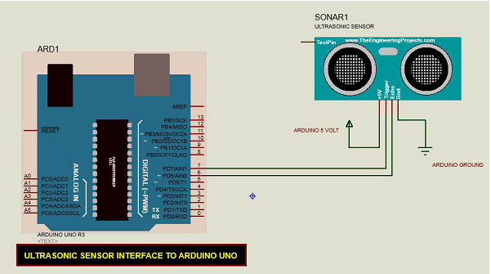
Cont…

Slide 38
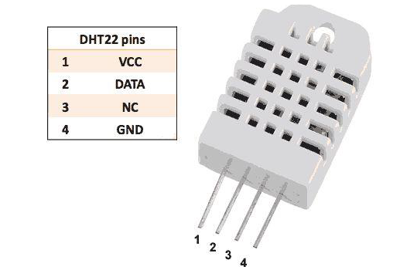
Humidity Sensor
is a digital-output, relative humidity, and temperature sensor.
It uses a capacitive humidity sensor and a thermistor to measure the surrounding air, and sends a digital signal on the data pin.
The connections are simple. The first pin on the left to 3-5V power
The second pin to the data input pin and
The right-most pin to the ground.

Slide 39
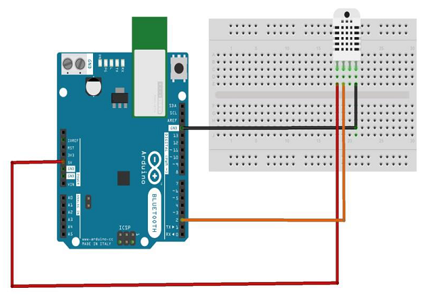
Cont…

Slide 40
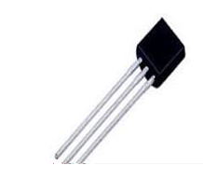
Temperature sensor
The Temperature Sensor LM35 series are precision integrated-circuit temperature devices with an output voltage linearly proportional to the Centigrade temperature.

Slide 41
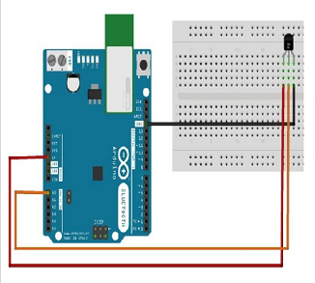
Cont…

Slide 42
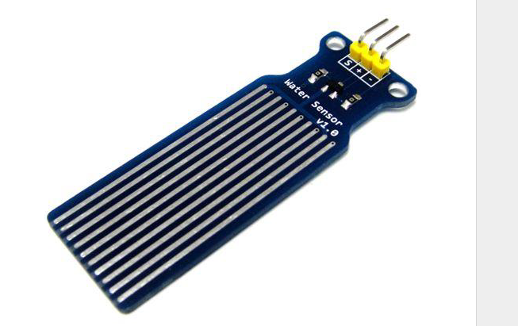
Water Detector / Sensor
Water sensor brick is designed for water detection, which can be widely used in sensing rainfall, water level, and even liquid leakage.

Slide 43
Cont…
Connecting a water sensor to an Arduino is a great way to detect a leak, spill, flood, rain, etc.
It can be used to detect the presence, the level, the volume and/or the absence of water.
While this could be used to remind you to water your plants, there is a better Grove sensor for that.

Slide 44
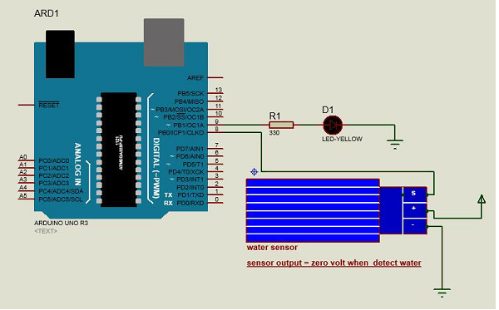
Cont…

Slide 45
actuator
we will interface different types of motors with the Arduino board (UNO) and show you how to connect the motor and drive it from your board.
There are three different type of motors −
DC motor
Servo motor
Stepper motor

Slide 46
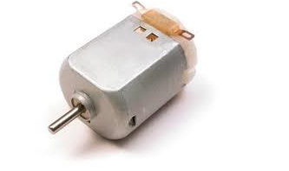
DC motor
A DC motor (Direct Current motor) is the most common type of motor.
DC motors normally have just two leads, one positive and one negative.
If you connect these two leads directly to a battery, the motor will rotate.
If you switch the leads, the motor will rotate in the opposite direction.
Warning − Do not drive the motor directly from Arduino board pins. This may damage the board. Use a driver Circuit or an IC.

Slide 47
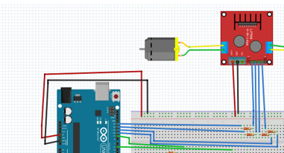
Cont…

Slide 48
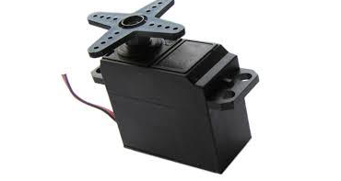
Servo Motor
A Servo Motor is a small device that has an output shaft.
This shaft can be positioned to specific angular positions by sending the servo a coded signal.
As long as the coded signal exists on the input line, the servo will maintain the angular position of the shaft.
If the coded signal changes, the angular position of the shaft changes.
They are also used in radio-controlled cars, puppets, and of course, robots.

Slide 49
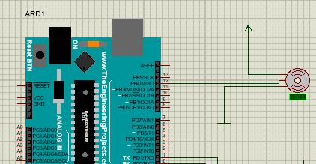
Cont…

Slide 50
Stepper Motor
A Stepper Motor or a step motor is a brushless, synchronous motor, which divides a full rotation into a number of steps.
Unlike a brushless DC motor, which rotates continuously when a fixed DC voltage is applied to it, a step motor rotates in discrete step angles.
The Stepper Motors therefore are manufactured with steps per revolution of 12, 24, 72, 144, 180, and 200, resulting in stepping angles of 30, 15, 5, 2.5, 2, and 1.8 degrees per step.
The stepper motor can be controlled with or without feedback.

Slide 51
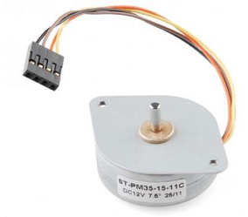
Cont.…
A regular DC motor spins in only direction whereas a Stepper motor can spin in precise increments.
Stepper motors can turn an exact amount of degrees (or steps) as desired.

Slide 52
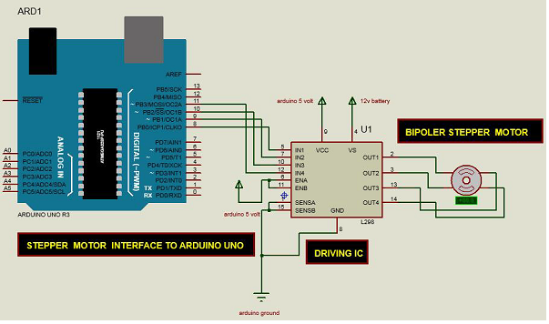
Cont.….

Slide 53
Thanks

